Slide 1
Lecture 4 Logic Programming & CSP
AY 2025-26

Slide 2
Constraint Satisfaction Problems
Constraint-Satisfaction Problem
CSP Components
Representations
Code Implementations

Slide 3
Constraint Satisfaction Problem (CSP)
Constraint Satisfaction Problems (CSPs) are a class of problems in computer science and artificial intelligence that involve finding solutions that satisfy a set of constraints.
A problem is solved when each variable has a value that satisfies all the constraints on the variable.
The main idea is to eliminate large portions of the search space all at once by identifying variable/value combinations that violate the constraints.

Slide 4
CSP Components
Variables
Domains
Constraints

Slide 5
Variables
A variable represents an entity or a quantity that we want to assign a value to in order to find a solution that satisfies the given constraints.
can take different forms depending on the nature of the problem.
They can represent discrete quantities, such as numbers, colors, or symbols, or they can represent continuous quantities with specified ranges or intervals.
For example, each cell in sudoku represents a variable.

Slide 6
Domains
Each variable in a CSP has an associated domain, which is a set of possible values that the variable can take.
The domain represents the range of valid options for the variable.
In sudoku puzzle, the domain of each variable is the set of numbers from 1 to 9.

Slide 7
Constraint
Constraints define rules and conditions that restrict the possible combinations of values for the variables.
In sudoku, some example constraints are:
Row constraint: each row in sudoku must contain all digits from 1 to 9; none of these digits could be repeated
Column constraint;
Box/ Square constraint: Each 3x3 box in Sudoku grid must contain all the digits from 1 to 9 exactly once; none of these digits could be repeated

Slide 8
Constraint: Some variations
Constraints can take various forms depending on the nature of the problem.
Some common types of constraints include:
Unary constraints - involves a single variable only (e.g., the value of “x” must be even.)
Binary Constraints – the restrictions involve two variables (e.g., “x” and “y” must be different)
Global Constraints – involves multiple variables (e.g., “all-different constraint” – as its name implies, all the variables in the problem must be different.)

Slide 9
Components: Representations
In representation, the components of CSPs could be represented in the follow ways:
X denotes a set of variables, {X₁, . . . ,X_{n}}.
D denotes a set of domains, {D₁, . . . ,D_{n}}, one for each variable.
C denotes a set of constraints that specify allowable combinations of values.
CSP =
Variables +
Domains +
Constraints

Slide 10
An Example
Problem: Suppose we are required to find all the combinations of two integers (0~9) where one is twice of the other.
X: two integers (“a” & “b” for example)
D: 0 – 9
C: b is 2 times of a / “a = b / 2”

Slide 11
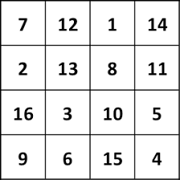
Another Example (1)
Problem: suppose we want to generate a 4 x 4 magic square.
***A 4x4 magic square is a square grid of 4 rows and 4 columns filled with distinct numbers from 1 to 16, where the sum of numbers in each row, column, and diagonal is the same. In other words, the sum of the numbers in each row, column, and diagonal of a 4x4 magic square is equal to the magic constant.***

Slide 12
Another Example (2)
X: 16 cells in the 4x4 magic square
D: 1 – 16
C:
“all-different constraint”;
The sum of diagonals equals 34;
The sum of rows equals 34;
The sum of columns equals 34

Slide 13
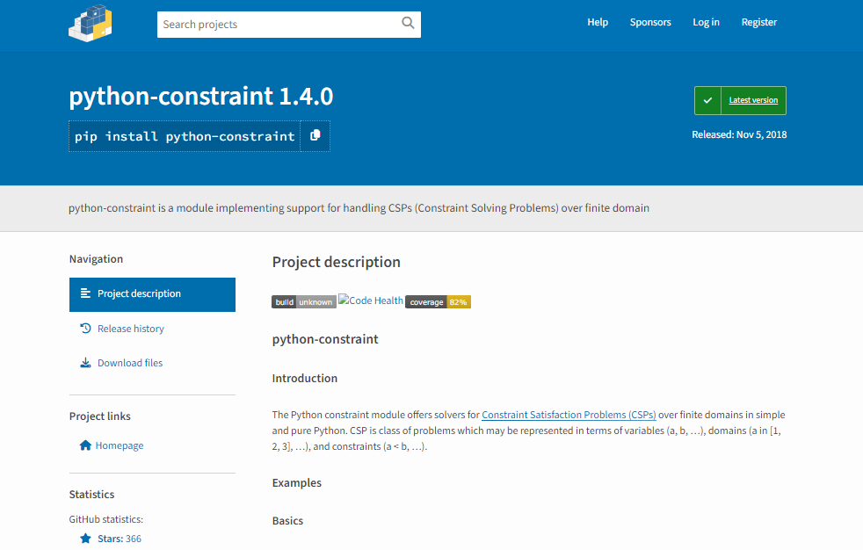

Code Implementations
We could implement the constraint satisfaction problems with python-constraint package.

Slide 14
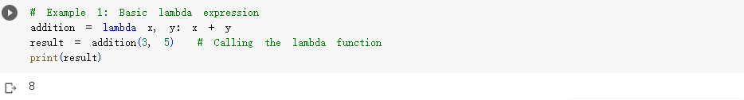
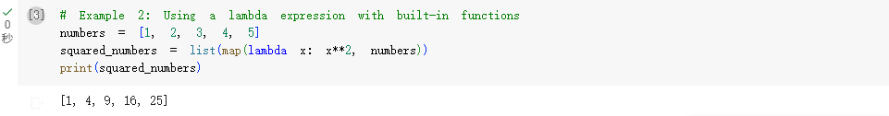
Python Lambda Expression
In Python, a lambda expression (also known as lambda function or anonymous function) is a way to create small, anonymous functions without explicitly defining a function using the def keyword.

Slide 15
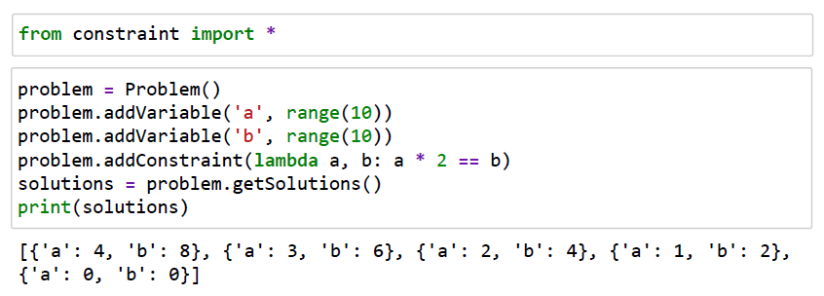
Examples (1)
Example 1: Find all possible combinations of two integers (0~9) where one is twice of the other.

Slide 16
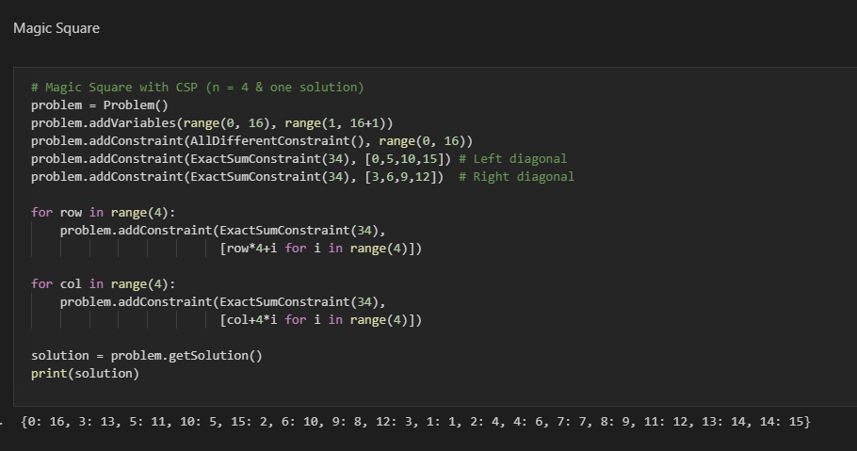
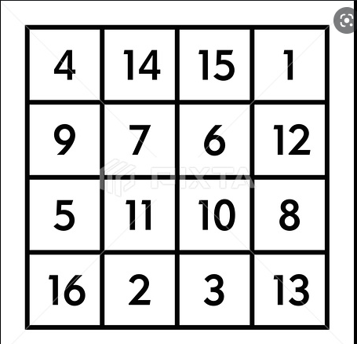
Examples (2)
Example 2: Generate all 4 × 4 magic square.

Slide 17
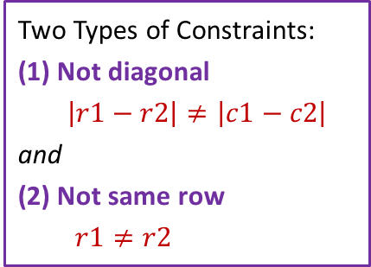

Examples (3)
Example 3: The goal of the N-Queens problem is to place n queens on an n x n chessboard such that no two queens threaten each other. This means no two queens can be in the same row, column, or diagonal.
Two Types of Constraints:
(1) Not diagonal
$\left|r1−r2\right|≠\left|c1−c2\right|$
and
(2) Not same row
$r1≠r2$
 | c1 | c2 | c3 | c4 | c5
r1 |  |  | Q
r2 | Q
r3 |  |  |  | Q
r4 |  | Q
r4 |  |  |  |  | Q
* There are ${{}_{5}^{}C}_{2}=10$ constraints.

Slide 18
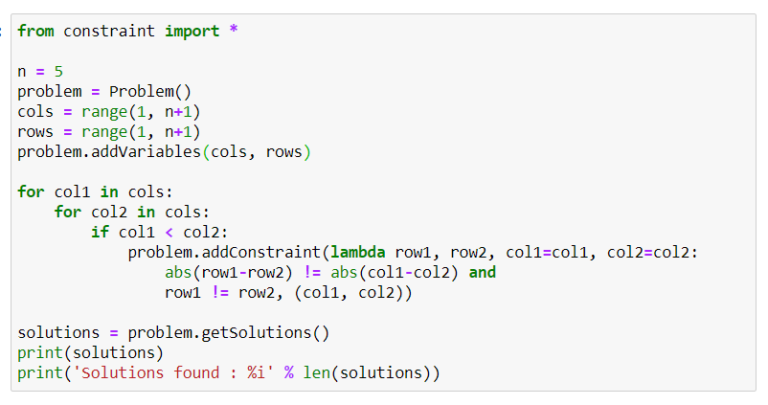
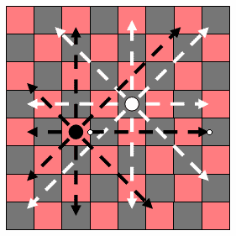
Examples (4)
Example 3: Generate all possible solutions of N-Queens Problem with n = 5.
AI_CSP.ipynb

Slide 19
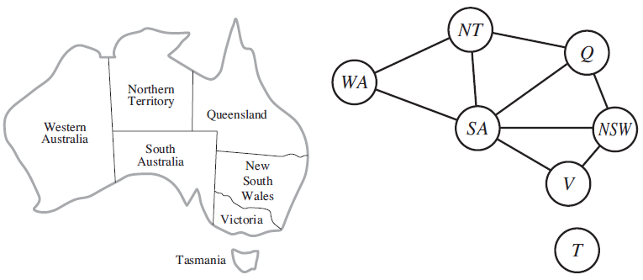
CSP Use Cases (1)
Example problem 1: Map coloring
Consider a map of Australia showing each of its states and territories:

Slide 20
CSP Use Cases (2)
Example problem 1: Map coloring (2)
We are given the task of coloring each region either red, green, or blue in such a way that no neighboring regions have the same color.
To formulate this as a CSP, we define the variables to be the regions
X = {WA, NT, Q, NSW, V, SA, T} .
The domain of each variable is the set
D_{i} = {red , green, blue} .

Slide 21
CSP Use Cases (3)
Example problem 1: Map coloring (3)
The constraints require neighboring regions to have distinct colors.
Since there are nine places where regions border, there are nine constraints:
C = {SA ≠ WA, SA ≠ NT, SA ≠ Q, SA ≠ NSW, SA ≠ V, WA ≠ NT, NT ≠ Q, Q ≠ NSW, NSW ≠ V } .
There are many possible solutions to this problem, such as
{WA = red, NT = green, Q = red, NSW = green, V = red, SA = blue, T = red} .

Slide 22
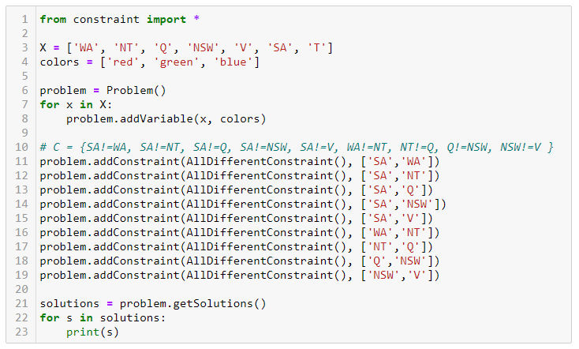
CSP Use Cases (4)
Map coloring: Implementation

Slide 23
CSP Use Cases (5)
Example problem 2: SEND + MORE = MONEY
Consider the problem of finding a digit (0~9) for each of the following letters:
S E N D
+ M O R E
M O N E Y
Different letters should represent different digits.
How can we use CSP to solve this problem?

Slide 24
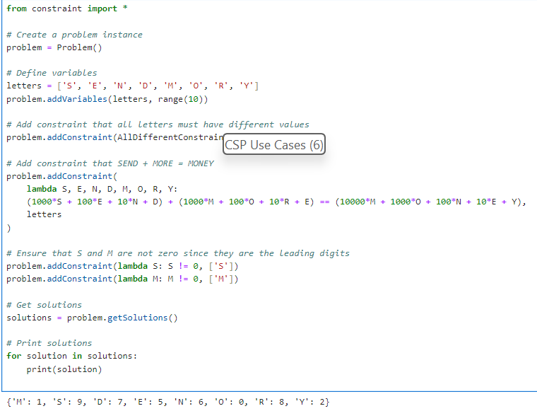
CSP Use Cases (6)
CSP_SEND.ipynb

Slide 25

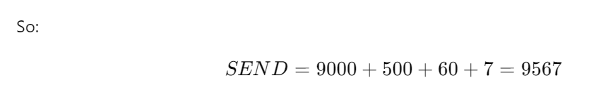
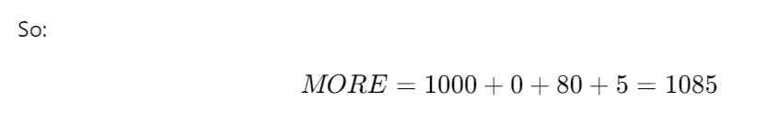



Slide 26
CSP Use Cases (7)
 |  | 8 |  |  | 6
 |  | 4 | 3 | 7 | 9 | 8
5 | 7 |  |  | 1 |  | 3 | 2
 | 5 | 2 |  |  | 7
 | 6 |  | 5 | 9 | 8 |  | 4
 |  |  | 4 |  |  | 5 | 7
 | 2 | 1 |  | 4 |  |  | 9 | 8
 |  | 9 | 6 | 2 | 3 | 1
 |  |  | 9 |  |  | 7
Example problem 3: Sudoku
What digit should be filled in each of the missing cell?

Slide 27
CSP Use Cases (8)
Define variables and domains
CSP_Sudoku.ipynb
ROWS = 'abcdefghi'
COLS = '123456789'
DIGITS = range(1, 10)
VARS = [row + col for row in ROWS for col in COLS]
ROWGROUPS = [[row + col for col in COLS] for row in ROWS]
COLGROUPS = [[row + col for row in ROWS] for col in COLS]
SQUAREGROUPS = [
[ROWS[3 * rowgroup + k] + COLS[3 * colgroup + j]
for j in range(3) for k in range(3)]
for colgroup in range(3) for rowgroup in range(3)
]
Example problem 3: Sudoku

Slide 28
CSP Use Cases (9)
Add variables and constraints
def solve(hints):
problem = Problem()
for var, hint in zip(VARS, hints):
problem.addVariables([var],
[hint] if hint in DIGITS else DIGITS)
for vargroups in [ROWGROUPS, COLGROUPS, SQUAREGROUPS]:
for vargroup in vargroups:
problem.addConstraint(
AllDifferentConstraint(), vargroup)
return problem.getSolution()
Example problem 3: Sudoku

Slide 29
CSP Use Cases (10)
Format solutions
def pretty(var_to_value):
board = ''
for rownum, row in enumerate('abcdefghi'):
for colnum, col in enumerate('123456789'):
board += str(var_to_value[row+col])
if colnum % 3 == 2:
board += ' '
board += '\n'
if rownum % 3 == 2:
board += '\n'
return board
Example problem 3: Sudoku

Slide 30
CSP Use Cases (11)
Define initial state
hints = (
0, 0, 8, 0, 0, 6, 0, 0, 0,
0, 0, 4, 3, 7, 9, 8, 0, 0,
5, 7, 0, 0, 1, 0, 3, 2, 0,
0, 5, 2, 0, 0, 7, 0, 0, 0,
0, 6, 0, 5, 9, 8, 0, 4, 0,
0, 0, 0, 4, 0, 0, 5, 7, 0,
0, 2, 1, 0, 4, 0, 0, 9, 8,
0, 0, 9, 6, 2, 3, 1, 0, 0,
0, 0, 0, 9, 0, 0, 7, 0, 0,
)
Example problem 3: Sudoku

Slide 31
CSP Use Cases (12)
Print solution
print(pretty(solve(hints)))
938 256 417
214 379 865
576 814 329
452 137 986
167 598 243
893 462 571
321 745 698
789 623 154
645 981 732
Example problem 3: Sudoku

Slide 32
4. Logic Programming
Programming Paradigms
Logic Programming: An Overview
Unification and Backtracking
Logic Programming with Python

Slide 33
Logic Programming
Logic programming is a programming paradigm that is based on formal logic and uses logical rules and inference to solve problems.
In logic programming, programs are composed of facts and rules expressed in a logic-based language.
The most common logic programming language is Prolog, which stands for "Programming in Logic." In Prolog, you define a knowledge base consisting of facts and rules, and you can query this knowledge base to obtain solutions to problems.

Slide 34
Logic Programming: An Overview
Logic Programming uses facts and rules for solving the problem.
That is why they are called the building blocks of logic programming.
A goal needs to be specified for every program in logic programming.
Facts
Actually, every logic program needs facts to work with so that it can achieve the given goal.

Slide 35
Logic Programming: An Overview (2)
Facts basically are true statements about the program and data.
For example, Beijing is the capital of China.
Rules
Rules are the constraints which allow us to make conclusions about the problem domain.
Rules basically written as logical clauses to express various facts.
For example, if we are building any game then all the rules must be defined.

Slide 36
Logic Programming: An Overview (3)
Rules are very important to solve any problem in Logic Programming. Rules are basically
logical conclusion which can express the facts. Following is the syntax of rule:
A:- B₁,B₂,...,B_{n}.
Here, A is the head and B₁, B₂, ... B_{n} is the body.
For example:
ancestor(X,Y):- father(X,Y).
ancestor(X,Z):- father(X,Y), ancestor(Y,Z).
A if B₁ and … and B_{n}.

Slide 37
Logic Programming: An Overview (4)
Here is a logic program in Prolog:
parent(joe, jane).
parent(harry, carl).
parent(meg, jane).
parent(jane, anne).
parent(carl, ralph).
parent(hazel, harry).
grandparent(X, Z) :-
parent(X, Y), parent(Y, Z).
?- parent(meg, jane).
yes.
?- parent(carl, joe).
no.
?- grandparent(A, ralph).
A = harry;
no.
Facts
(Database)
Rule
Queries

Slide 38
Logic Program Engine (LPE)
Unification
Backtracking

Slide 39
Unification
The process of finding substitutions for variables in logical expressions
such that the expression become equal and compatible
For example, a LPE can unify the terms cat(A), and cat(mary) by binding variable A to atom mary that means we are giving the value mary to variable A.
A LPE can unify person(Kevin, dane) and person(L, S) by binding L and S to atom kevin and dane, respectively.
Sometimes it is called binding the variables to values

Slide 40
Logic Program Engine (LPE)
Unification
Backtracking

Slide 41
Backtracking (1)
In the process of backtracking, a LPE will go back to the previous goal, and after that, it will try to find another way to satisfy the goal.
If the current solution fails, backtracking allows for exploring alternative solutions.

Slide 42
Backtracking (2)
Here's a simplified explanation of how backtracking works:
The system starts by attempting to satisfy the first goal or query.
If the goal is satisfied, it continues to the next goal or query.
If the goal fails, the system backtracks to the previous choice point and explores alternative choices.
The system then continues the search from the alternative choice point, either trying a different possibility or exploring a different branch.
If all possibilities and branches have been exhausted, and no more solutions are found, the search terminates.

Slide 43
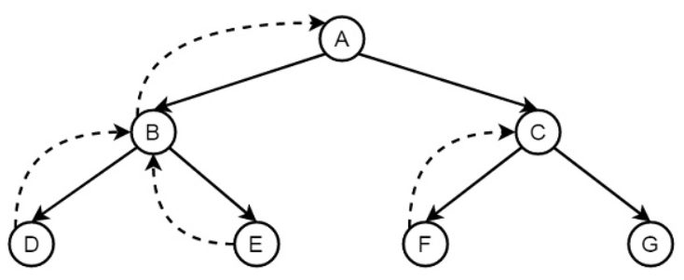
Backtracking: An Illustration (1)
When it finds that D is not the destination, it backtracks to B, then go to E, and backtracks again to B and then A, …
When it finds G (the goal), it stops.

Slide 44
Backtracking: An Illustration (2)
X = {Q, NSW, V, T, SA, WA, NT}
We would follow a chronological order for assignments.

Slide 45
Backtracking: An Illustration (3)
X = {Q, NSW, V, T, SA, WA,NT}
Q = Red

Slide 46
Backtracking: An Illustration (4)
X = {Q, NSW, V, T, SA, WA,NT}
Q = Red
NSW = Green

Slide 47
Backtracking: An Illustration (5)
X = {Q, NSW, V, T, SA, WA,NT}
Q = Red
NSW = Green
V = Blue

Slide 48
Backtracking: An Illustration (6)
X = {Q, NSW, V, T, SA, WA,NT}
Q = Red
NSW = Green
V = Blue
T = Red
SA = no legal value

Slide 49
Backtracking: An Illustration (7)
Solution:
The backjumping method backtracks to the most recent assignment in the conflict set.
Goto: T (assume we know T is not relevant)
Goto: V
Try other values for V
E.g. Red

Slide 50
Logic Programming with Python
For starting logic programming in Python, we need to install the following two packages:
Kanren (minikanren): express the logic in terms of rules and facts.
SymPy (sympy): a Python library for symbolic mathematics.

Slide 51
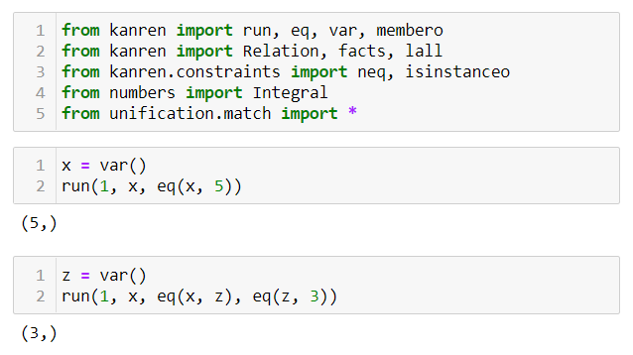
Logic Programming with Python (2)
AI_LP.ipynb
Install
minikanren

Slide 52
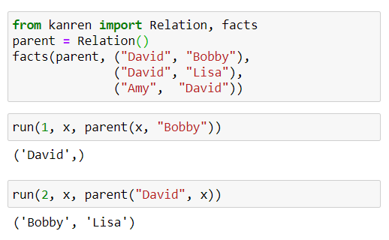
Logic Programming with Python (3)
Define “parent” relation
The variable x will be unified to ‘David’.
Notes:
pp.52 - 55

Slide 53
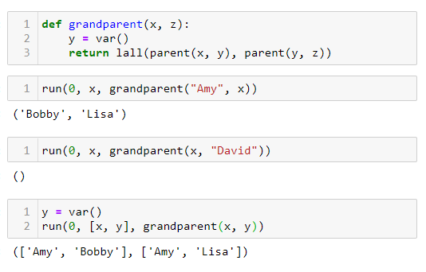
Logic Programming with Python (4)
Define “grandparent” rule
The parameter ‘0’ will allow the LPE to backtrack to all possible solutions.

Slide 54
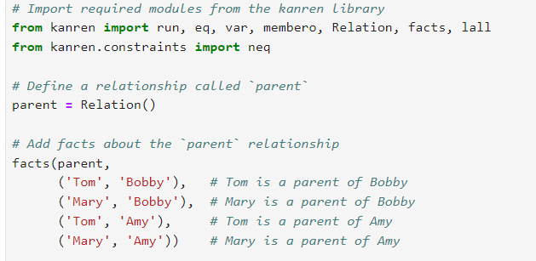

Slide 55
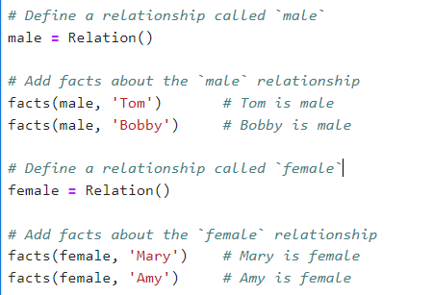

Slide 56
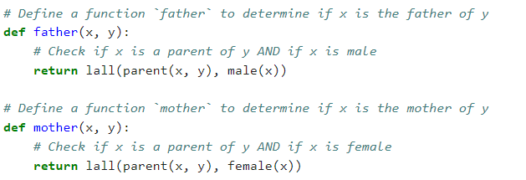

Slide 57
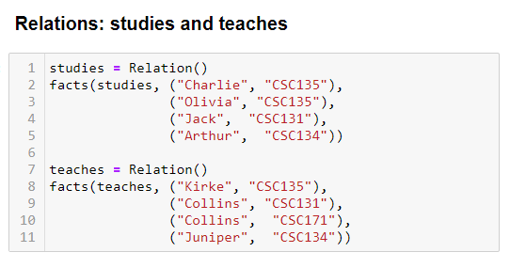
Logic Programming with Python (5)
Student-Professor Relation

Slide 58
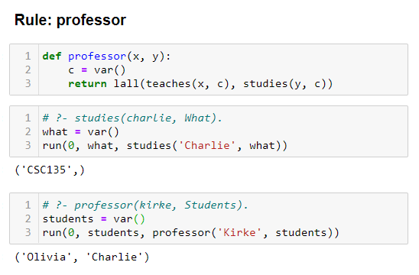
Logic Programming with Python (6)
Student-Professor Relation (2)

Slide 59

Self Study Guide

Slide 60
Self Study Guide
References
Russell, S. and Norvig, P. (2020). Artificial Intelligence: A Modern Approach (4th ed.). Upper Saddle River, NJ: Pearson.
Joshir, P. (2017). Artificial Intelligence with Python (1st ed.). Birmingham: Packt Publishing.

Slide 61
Self Study Guide
Useful Sites
https://www.javatpoint.com/artificial-intelligence-tutorial
http://artint.info/AIPython/
https://github.com/brandonwillard/kanren
https://pypi.org/project/python-constraint/
http://labix.org/doc/constraint/

